Slide 1
Simple Linear Regression Part 2

Slide 2
Simple Linear Regression!!!
Assumptions

Slide 3
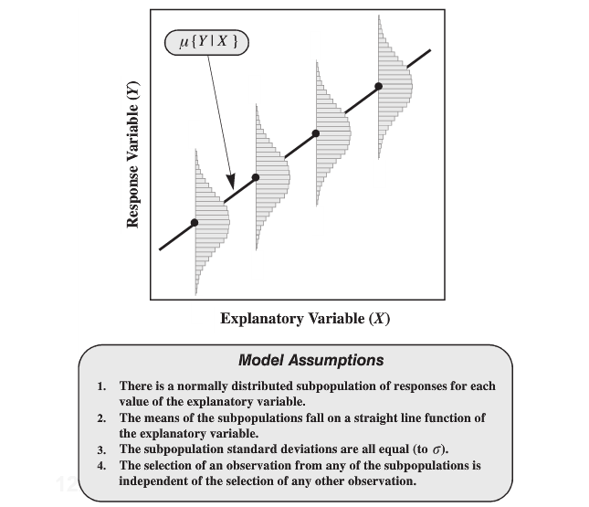
Assumptions

Slide 4
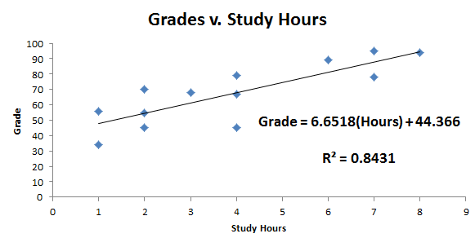
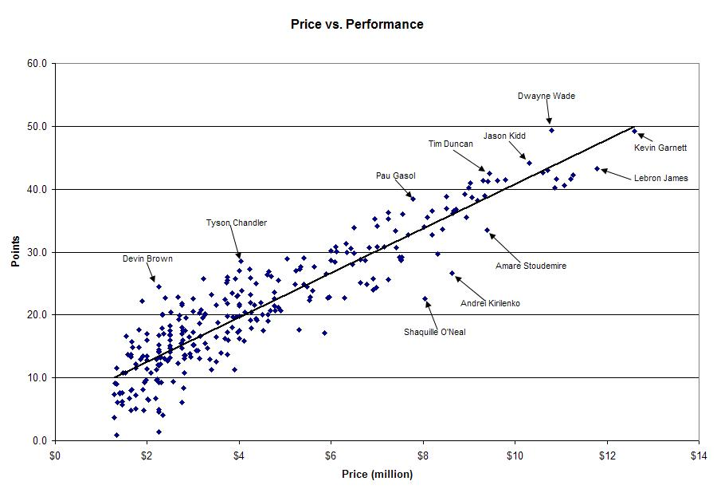

$\hat{μ}\{Grade|Hours\}$=6.6518(Hours) + 44.366
$\hat{μ}\{Points|Price\}$= 3.5 (Price) + 6

Slide 5
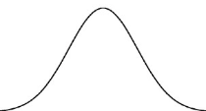

Assumptions
$\hat{μ}\{Points|Price\}$= 3(Price) + 6
There is an NBA salary cap &
only so many points can be scored in a game…

Slide 6



Grades v. Study Hours
$\hat{μ}\{Grade|Hours\}$=6.6518(Hours) + 44.366
Hours = 3
Hours = 7
$$σ$$
$$σ$$
63.92
89.99
Distribution of Grades
when Hours = 3
Distribution of Grades
when Hours = 7

Slide 7



r = .907
r² = 0. 823
^
Points = 6 + 3.5(Price)
Price = 2
Price = 6
Price = 10.5
$$σ$$
$$σ$$
$$σ$$
13
27
42.75
Distribution of Points
Distribution of Points
Distribution of Points

Slide 8
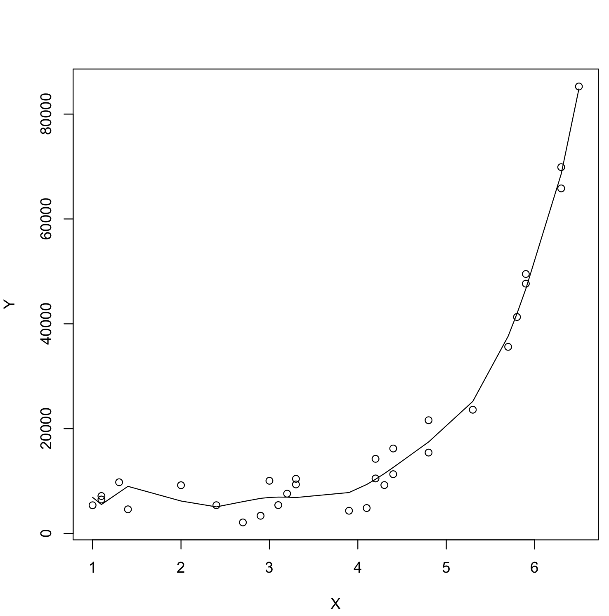
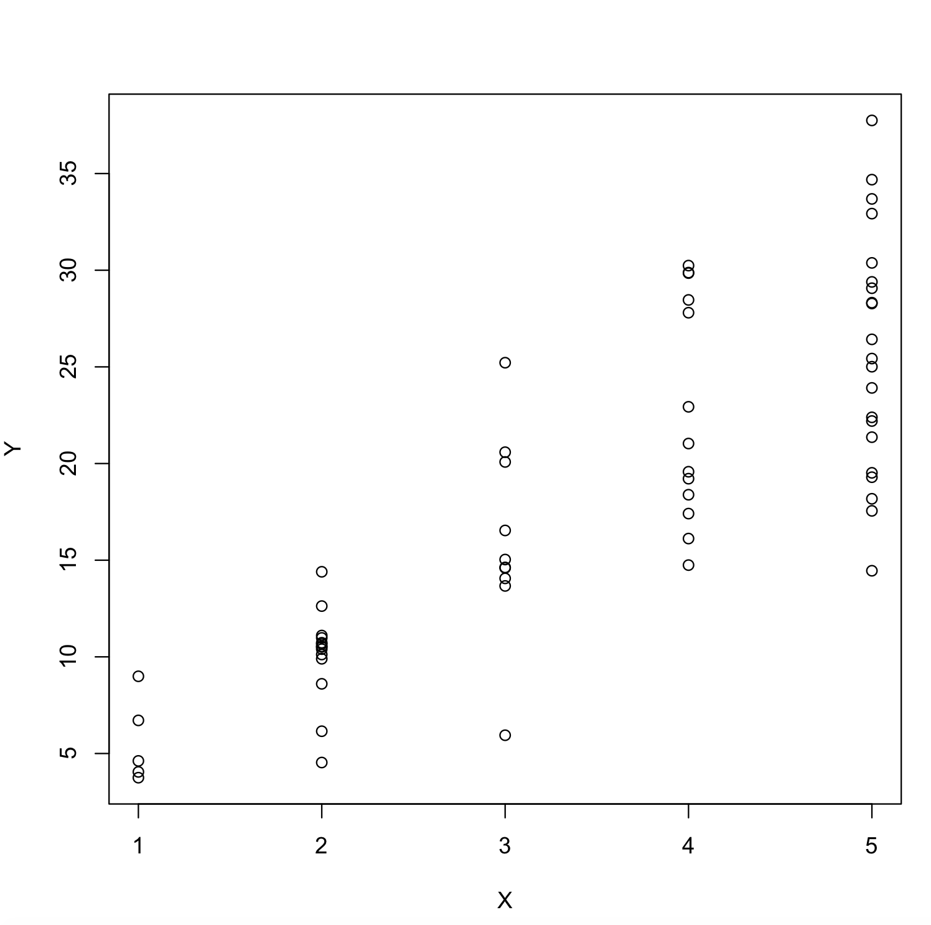

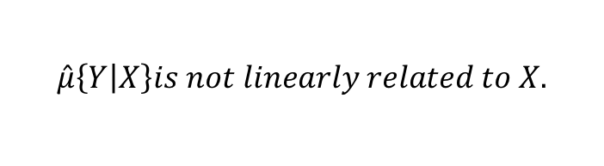
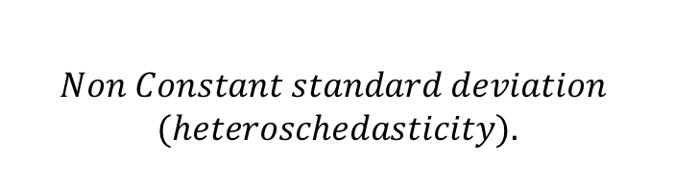
Violations of Assumptions
$$Non Constant standard deviation$$
$$(heteroschedasticity).$$
$$\hat{μ}\left\{Y | X\right\}is not linearly related to X.$$

Slide 9
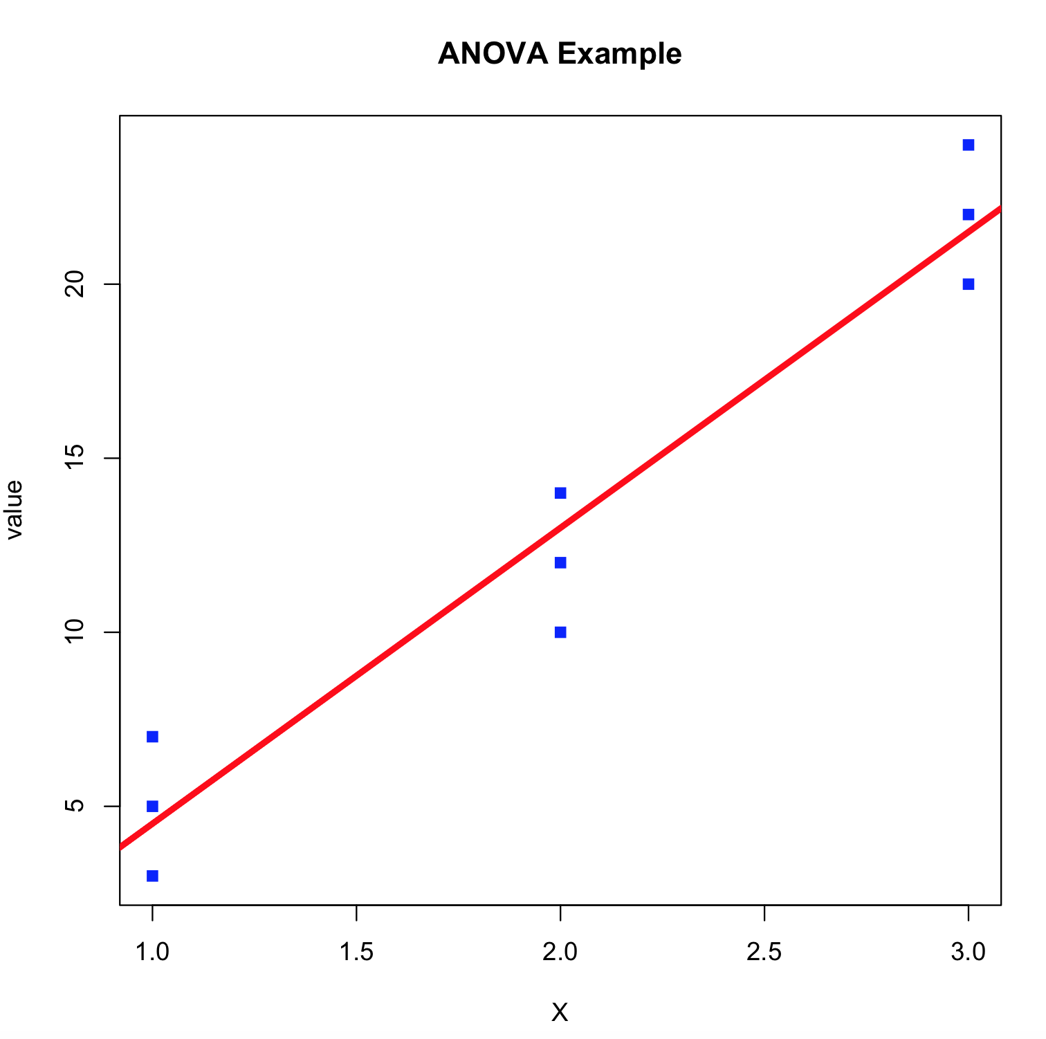
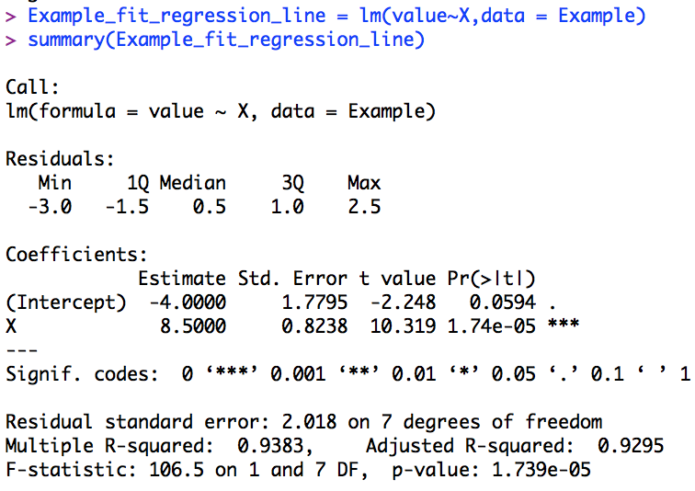




Constant SD!
$$Model: \hat{Y}=−4+8.5X$$
$$Model: \hat{μ}=−4+8.5X$$
$$\hat{σ}=2.02$$
$$\hat{σ}=2.02$$
$$\hat{σ}=2.02$$

Slide 10

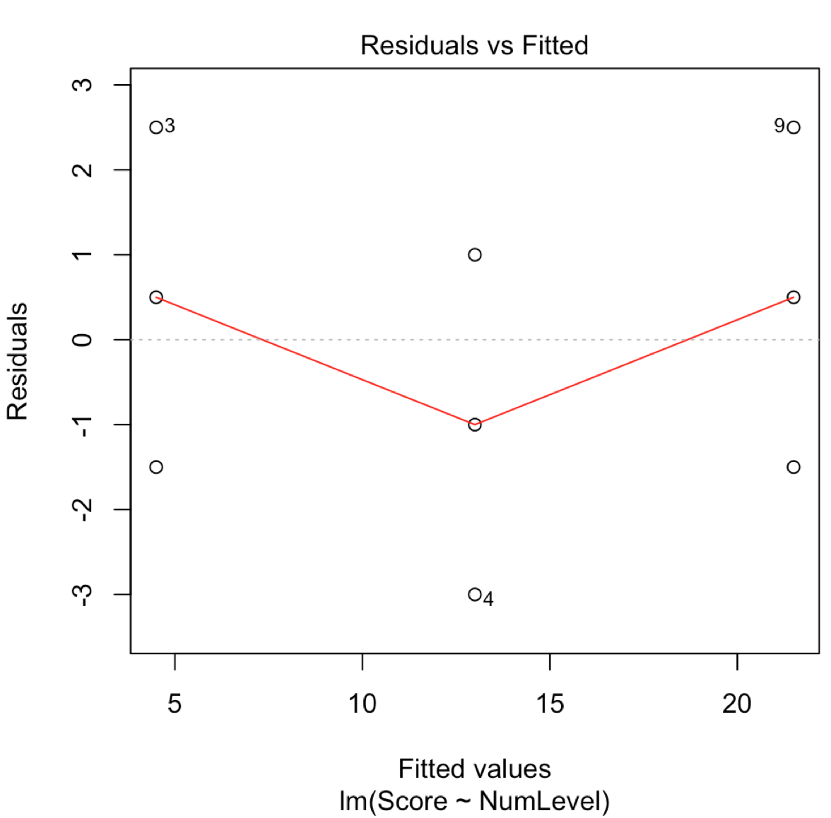
Residual Plots
Normality: There are no notable outliers that contest the normality assumption. We will assume the response is normally distributed conditional on the Xs.
Linearity: There is no evidence against the mean of those normal distributions being linearly related to the Xs.
Constant SD: There is no evidence against equal standard deviation of the normal distribution across the Xs.
Independence: We will assume the observation are independent of one another.
Normality:
Linearity:
Constant SD:
Independence:

Slide 11
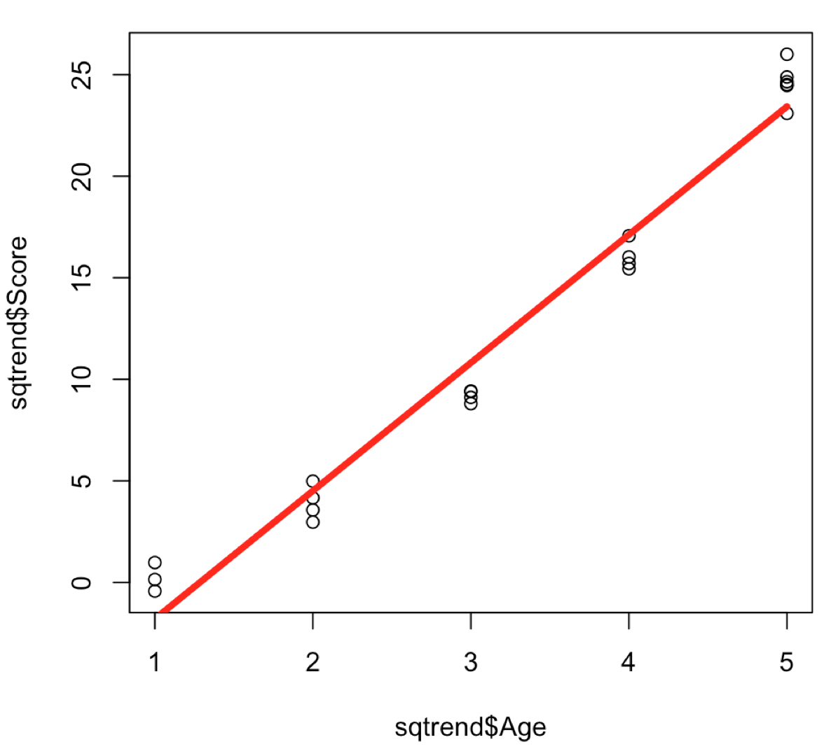
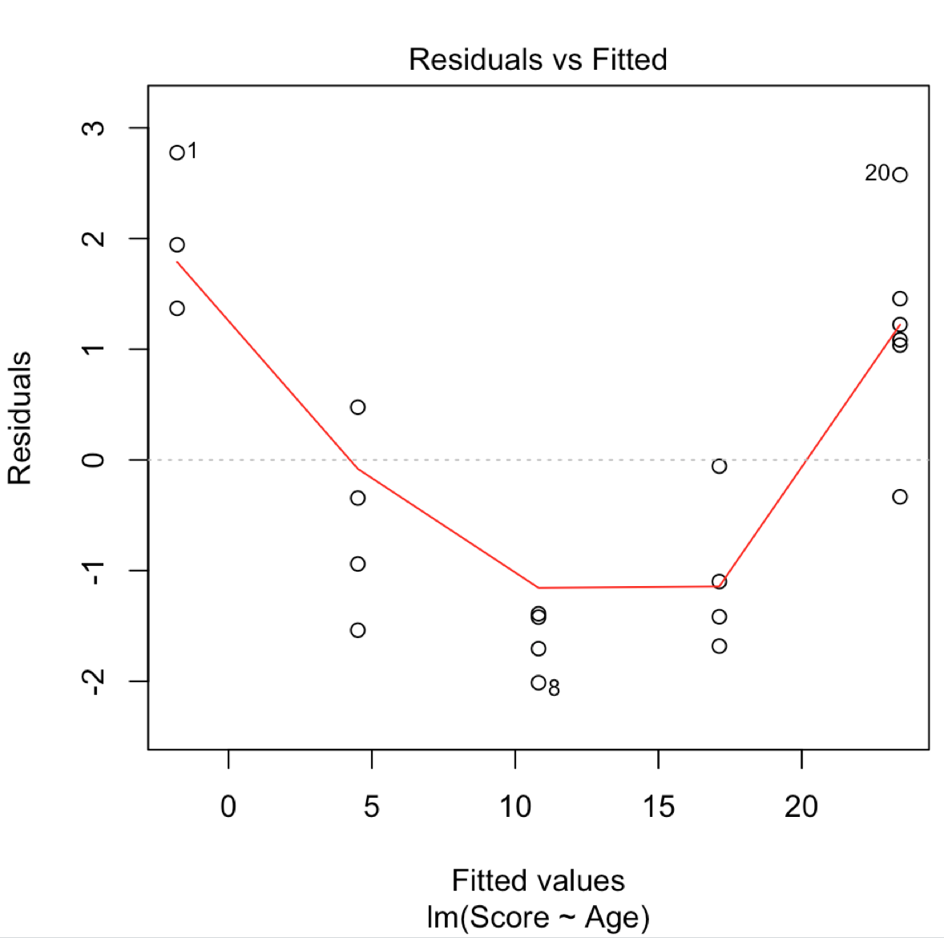
Residual Plot (Curved Trend)
Normality: There are no notable outliers that contest the normality assumption. We will assume the response is normally distributed conditional on the Xs.
Linearity: There is strong evidence of a curvilinear relationship between the means of the distribution of the response and the x variable.
Constant SD: There is no evidence against equal standard deviation of the normal distribution across the Xs.
Independence: We will assume all the of X,Y pairs are independent.
Normality:
Linearity:
Constant SD:
Independence:

Slide 12
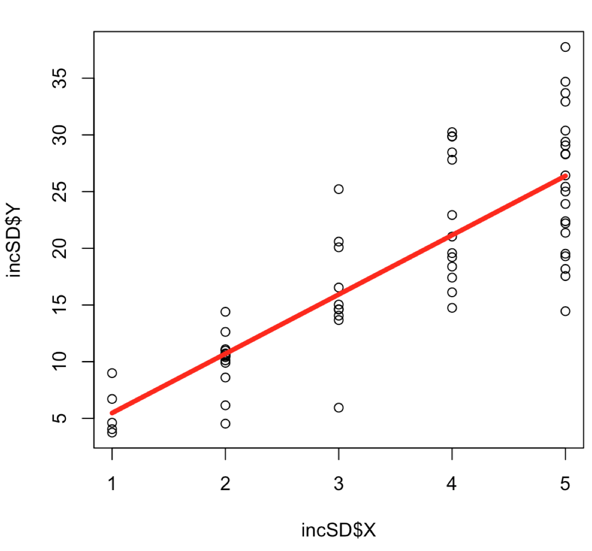
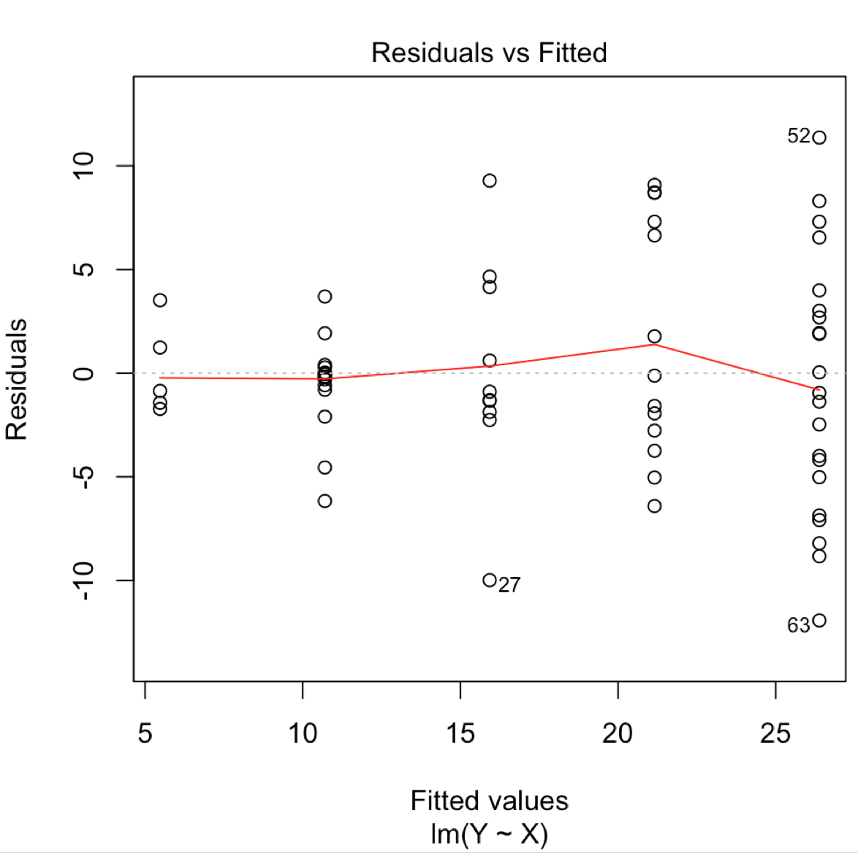
Residual Plot (Non-Constant SD)
Normality: There are no notable outliers that contest the normality assumption. We will assume the response is normally distributed conditional on the Xs.
Linearity: There is no evidence against the mean of those normal distributions being linearly related to the Xs.
Constant SD: There is strong evidence that the standard deviation of the distributions of the response is increasing with increasing x.
Independence: We will assume all the of X,Y pairs are independent.
Normality:
Linearity:
Constant SD:
Independence:

Slide 13
You Try It!
In R there is a dataset called “mpg” which has the city mpg, highway mpg, and other various characteristics of 234 cars.
Conduct an analysis with simple linear regression of the city mpg (y: cty) versus the displacement of the engine (x: displ). Check the assumptions of this model with a residual plot. Even if the assumptions are not met, use the model to predict the city mpg for a car with a displacement of 6 liters. If the assumptions are met, interpret the slope with a 95% confidence interval.

Slide 14
You Try It!
In R there is a dataset called “mpg” which has the city mpg, highway mpg, and other various characteristics of 234 cars.
Conduct an analysis with simple linear regression of the city mpg (y: cty) versus the highway mpg (x: hwy). Check the assumptions of this model with a residual plot. Even if the assumptions are not met, use the model to predict the city mpg for a car with a highway mpg of 37 mpg. If the assumptions are met, interpret the slope with a 95% confidence interval.

